Slide 1
OR2012
Notes:
-- respond to the discussions that have taken place during the day
-- SSRN is so different in scale and nature to institutional repositories
-- -- reflect on where your concerns and interests differ from what you've heard
-- -- off-the-cuff response to tweets or other discussions
-- -- estimating the costs of dealing with data, from the perspective of a for-profit organisation
-- information that repositories need to provide to help people make informed choices about what to deposit with them and why
Many research datasets could be profitably reanalyzed, but are in danger of being lost since they are never properly archived. Institutional Repositories are charged with preserving scholarly products, but not all feel prepared to curate and archive research data. Institution-wide data repositories may co-exist with others within and beyond their institution, subject-based archives serving national and international communities, and publisher repositories. The workshop will offer service providers in these contexts a snapshot of the current landscape, and share examples, models and metaphors to help plan future development. We aim to map points of consensus and concern around repository roles in supporting data reuse and developing the infrastructure for that.

Slide 2

A Little Glue for Data Repositories
Gregg_Gordon@SSRN.Com
SSRNblog.com
twitter: @SSRN
facebook: SSRNCommunity
linkedin: groupid=40866
Notes:
Thx to each of you for being here …
THIS IS A CONVERSATION NOT A LECTURE!

Slide 3

What does SSRN do?
- online repository of non-refereed working and refereed papers
- email/RSS alerts and web access to this content
- non-exclusive license to post/distribute but does not take a copyright
Notes:
First, let’s look at what SSRN does – no copyright is a critical component
But most importantly – SSRN IS A LEVEL PLAYING FIELD
No preference for name or affiliation
Every scholar has the opportunity to present their ideas and share them
Especially beneficial for PhD candidates and young scholars to find new research and research ideas
AND we think DATA too!

Slide 4
Notes:
Internationalization is area that all of us need to be keenly focused on. Accessibility is one of SSRN’s top strategic focus areas and we are working with partners to provide non-English wrappers to enhance it.
NEW: Hebrew and India networks
IDEA: slum research has applicability around the world

Slide 5
image created with http://www.wordle.net

Slide 6
Daily Submissions & Revisions
Notes:
outliers omitted, 60k submissions
revisions have exceeded submissions several times in last few months
revisions equal author submissions over last few months

Slide 7
New Authors

Slide 8
Annual Downloads
Notes:
SSRN delivered ~19M downloads last year and only “counted” half of them. [EXPLAIN]

Slide 9
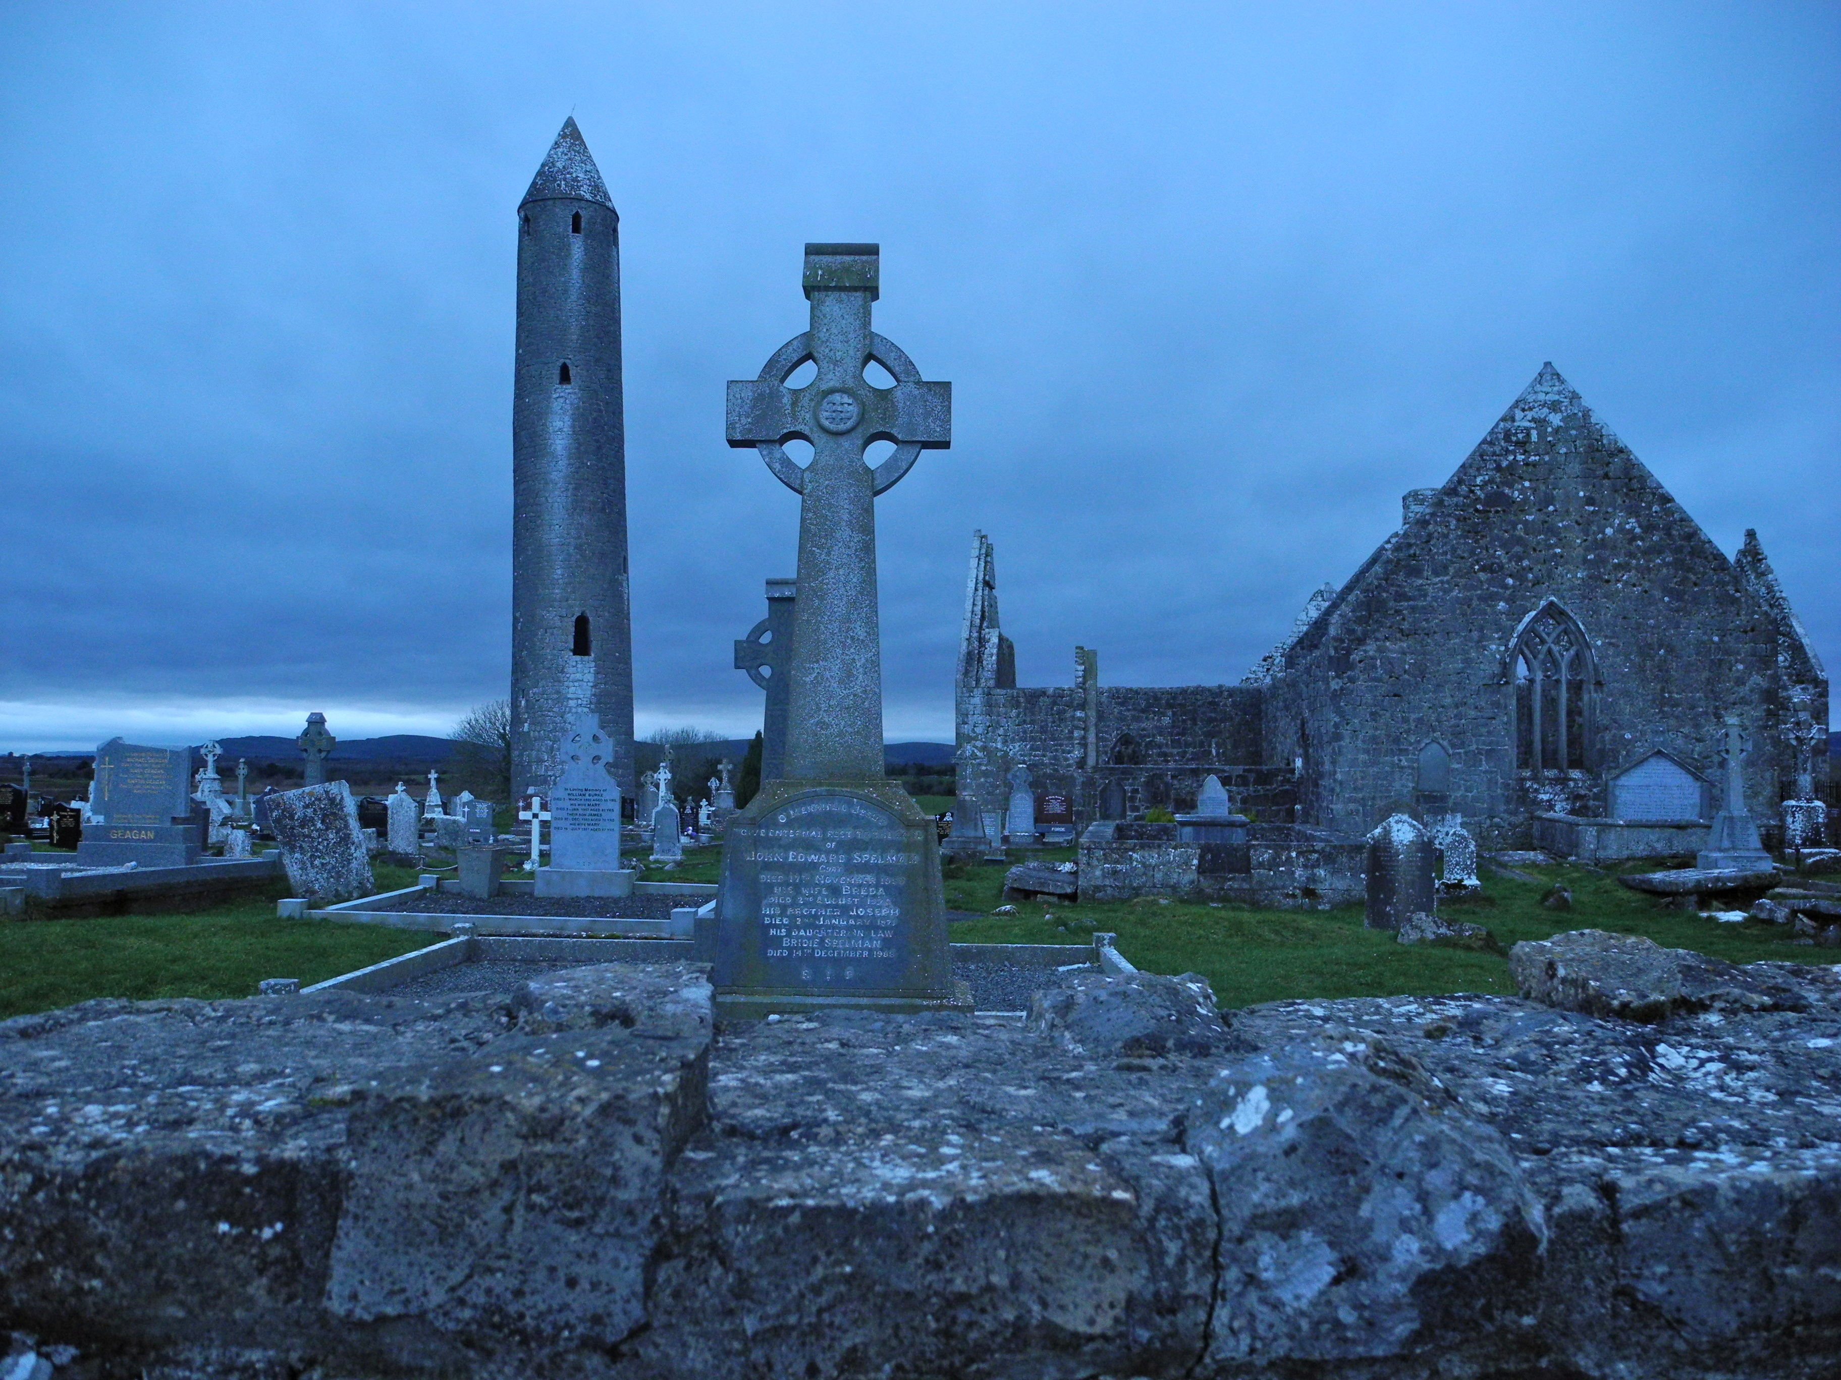
What about data?
Notes:
What do we do with it?
Why don’t we share?
Is it destined to wind up in Dorothea’s Roach Motel?

Slide 10
What about data (and code)?
Notes:
What do we do with it?
Why don’t we share?
Is it destined to wind up in Dorothea’s Roach Motel?

Slide 11
WHO?
A new scientific truth does not triumph by convincing its opponents and making them see the light, but rather because its opponents eventually die, and a new generation grows up that is familiar with it
- Max Planck

Slide 12
HOW DOES YOUR KINDERGARTEN CLASSROOM AFFECT YOUR EARNINGS? EVIDENCE FROM PROJECT STAR*
Raj Chetty, Harvard University and NBER
John N. Friedman, Harvard University and NBER Nathaniel Hilger, Harvard University
Emmanuel Saez, UC Berkeley and NBER
Diane Whitmore Schanzenbach, Northwestern University and NBER Danny Yagan, Harvard University
^{March 2011}
^{ABSTRACT}
In Project STAR, 11,571 students in Tennessee and their teachers were randomly as- signed to classrooms within their schools from kindergarten to third grade. This paper evaluates the long-term impacts of STAR by linking the experimental data to administrative records. We first demonstrate that kindergarten test scores are highly correlated with outcomes such as earnings at age 27, college attendance, home ownership, and retirement savings. We then document four sets of experimental impacts. First, students in small classes are significantly more likely to attend college and exhibit improvements on other outcomes. Class size does not have a significant effect on earnings at age 27, but this effect is imprecisely estimated. Second, students who had a more experienced teacher in kindergarten have higher earnings. Third, an analysis of variance reveals significant classroom effects on earnings. Students who were randomly assigned to higher quality classrooms in grades K-3 – as measured by classmates’ end-of-class test scores – have higher earnings, college attendance rates, and other outcomes. Finally, the effects of class quality fade out on test scores in later grades but gains in non-cognitive measures persist.
______________________________
*We thank Lisa Barrow, David Card, Gary Chamberlain, Elizabeth Cascio, Janet Currie, Jeremy Finn, Edward Glaeser, Bryan Graham, James Heckman, Caroline Hoxby, Guido Imbens, Thomas Kane, Lawrence Katz, Alan Krueger, Derek Neal, Jonah Rockoff, Douglas Staiger, numerous seminar participants, and anonymous referees for helpful discussions and comments.
We thank Helen Bain and Jayne Zaharias at HEROS for access to the Project STAR data. The tax data were accessed through contract TIRNO-09-R-00007 with the Statistics of Income (SOI) Division at the US Internal Revenue Service. Gregory Bruich, Jane Choi, Jessica Laird, Keli Liu, Laszlo Sandor, and Patrick Turley provided outstanding research assistance. Financial support from the Lab for Economic Applications and Policy at Harvard, the Center for Equitable Growth at UC Berkeley, and the National Science Foundation is gratefully acknowledged.

Slide 13
HOW DOES YOUR KINDERGARTEN CLASSROOM AFFECT YOUR EARNINGS? EVIDENCE FROM PROJECT STAR*
Raj Chetty, Harvard University and NBER
John N. Friedman, Harvard University and NBER Nathaniel Hilger, Harvard University
Emmanuel Saez, UC Berkeley and NBER
Diane Whitmore Schanzenbach, Northwestern University and NBER Danny Yagan, Harvard University
^{March 2011}
^{ABSTRACT}
In Project STAR, 11,571 students in Tennessee and their teachers were randomly as- signed to classrooms within their schools from kindergarten to third grade. This paper evaluates the long-term impacts of STAR by linking the experimental data to administrative records. We first demonstrate that kindergarten test scores are highly correlated with outcomes such as earnings at age 27, college attendance, home ownership, and retirement savings. We then document four sets of experimental impacts. First, students in small classes are significantly more likely to attend college and exhibit improvements on other outcomes. Class size does not have a significant effect on earnings at age 27, but this effect is imprecisely estimated. Second, students who had a more experienced teacher in kindergarten have higher earnings. Third, an analysis of variance reveals significant classroom effects on earnings. Students who were randomly assigned to higher quality classrooms in grades K-3 – as measured by classmates’ end-of-class test scores – have higher earnings, college attendance rates, and other outcomes. Finally, the effects of class quality fade out on test scores in later grades but gains in non-cognitive measures persist.
______________________________
*We thank Lisa Barrow, David Card, Gary Chamberlain, Elizabeth Cascio, Janet Currie, Jeremy Finn, Edward Glaeser, Bryan Graham, James Heckman, Caroline Hoxby, Guido Imbens, Thomas Kane, Lawrence Katz, Alan Krueger, Derek Neal, Jonah Rockoff, Douglas Staiger, numerous seminar participants, and anonymous referees for helpful discussions and comments.
We thank Helen Bain and Jayne Zaharias at HEROS for access to the Project STAR data. The tax data were accessed through contract TIRNO-09-R-00007 with the Statistics of Income (SOI) Division at the US Internal Revenue Service. Gregory Bruich, Jane Choi, Jessica Laird, Keli Liu, Laszlo Sandor, and Patrick Turley provided outstanding research assistance. Financial support from the Lab for Economic Applications and Policy at Harvard, the Center for Equitable Growth at UC Berkeley, and the National Science Foundation is gratefully acknowledged.

Slide 14
WHO?
One Day
- Raj Chetty

Slide 15
WHY?
A world constructed from the familiar is a world in which there’s nothing to learn …
- Eli Pariser
Notes:
A world constructed from the familiar is a world in which there’s nothing to learn ...
(since there is) invisible autopropaganda, indoctrinating us with our own ideas.
-- Eli Pariser in The Economist, 2011

Slide 16
WHY?
A world constructed from the familiar is a world in which there’s nothing to learn …
- Eli Pariser
Notes:
A world constructed from the familiar is a world in which there’s nothing to learn ...
(since there is) invisible autopropaganda, indoctrinating us with our own ideas.
-- Eli Pariser in The Economist, 2011

Slide 17
The Effect of Free Access on the Diffusion of Scholarly Ideas
^{Heekyung Hellen Kim}
^{MIT Sloan School of Management}
^{Abstract:}
This study examines a relationship between free access to research articles and the diffusion of their ideas as measured by citation counts. While free access should, in theory, help the diffusion of ideas, many researchers have debated the existence of the benefit of free access: reported empirical findings range from zero or negative effect to an over 300% increase of citations of non-free articles. By using a dataset from the Social Science Research Network (SSRN), an open repository of research articles, and employing a natural experiment that allows the estimation of the value of free access separate from confounding factors such as early viewership and quality differential, this study identifies the causal effect of free access on the citation counts. The natural experiment in this study is that a select group of published articles is posted on SSRN at a time chosen by their authors’ affiliated organizations or SSRN, not by their authors. Using a difference-in-difference method and comparing the citation profiles of the articles before and after the posting time on SSRN against a group of control articles with similar characteristics, I estimated the effect of the SSRN posting on citation counts. The articles posted on SSRN receive more citations even prior to being posted on SSRN, suggesting that they are of higher quality. Their citation counts further increase after being posted, gaining an additional 10-20% of citations. This gain is likely to be caused by the free access that SSRN provides.

Slide 18
The Effect of Free Access on the Diffusion of Scholarly Ideas
^{Heekyung Hellen Kim}
^{MIT Sloan School of Management}
^{Abstract:}
This study examines a relationship between free access to research articles and the diffusion of their ideas as measured by citation counts. While free access should, in theory, help the diffusion of ideas, many researchers have debated the existence of the benefit of free access: reported empirical findings range from zero or negative effect to an over 300% increase of citations of non-free articles. By using a dataset from the Social Science Research Network (SSRN), an open repository of research articles, and employing a natural experiment that allows the estimation of the value of free access separate from confounding factors such as early viewership and quality differential, this study identifies the causal effect of free access on the citation counts. The natural experiment in this study is that a select group of published articles is posted on SSRN at a time chosen by their authors’ affiliated organizations or SSRN, not by their authors. Using a difference-in-difference method and comparing the citation profiles of the articles before and after the posting time on SSRN against a group of control articles with similar characteristics, I estimated the effect of the SSRN posting on citation counts. The articles posted on SSRN receive more citations even prior to being posted on SSRN, suggesting that they are of higher quality. Their citation counts further increase after being posted, gaining an additional 10-20% of citations. This gain is likely to be caused by the free access that SSRN provides.

Slide 19
Modeling Scholarly Communication as an Information System
Steve Marks, Scholars Portal, Ontario Council of University Libraries
Andrea Kosavic,York University
Notes:
Berlin PKP Presentation - Modeling Scholarly Communication as an Information System
Steve Marks, Scholars Portal, Ontario Council of University Libraries
Andrea Kosavic,York University

Slide 20
Notes:
Berlin PKP Presentation - Modeling Scholarly Communication as an Information System
Steve Marks, Scholars Portal, Ontario Council of University Libraries
Andrea Kosavic,York University

Slide 21
Your Right Arm for a Publication in AER?
^{Arthur E. Attema}
^{Erasmus University Rotterdam}
^{Werner Brouwer}
^{Erasmus MC}
^{Job Van Exel}
Erasmus University Rotterdam (EUR) - Department of Health Policy & Management
^{January 31, 2012}
^{Abstract:}
The time tradeoff (TTO) method is popular in medical decision making for valuing health states. We use it to elicit economists’ preferences for publishing in top economic journals and living without limbs. The economists value the journals highly, and have a clear preference between them, with American Economic Review (AER) the most preferred. Their responses imply they would sacrifice more than half a thumb for publishing in AER. The TTO results are consistent with ranking and willingness to pay results, and indicate that preferences for journals are neither guided by influence factors, nor by expectations of a resulting salary rise.
Number of Pages in PDF File: 22
Keywords: Utility Measurement, Time Tradeoff, Willingness to pay, Publications
JEL Classifications: A10, B41, I10
Notes:
How Companies Win by Kash and Colhoun
supply driven economy WWII to 2007
demand driven economy now
focus on how things are consumed, not produced
seeing it in scholarly research
DELL – supply chain focus
APPLE – demand focus

Slide 22
Your Right Arm for a Publication in AER?
^{Arthur E. Attema}
^{Erasmus University Rotterdam}
^{Werner Brouwer}
^{Erasmus MC}
^{Job Van Exel}
Erasmus University Rotterdam (EUR) - Department of Health Policy & Management
^{January 31, 2012}
^{Abstract:}
The time tradeoff (TTO) method is popular in medical decision making for valuing health states. We use it to elicit economists’ preferences for publishing in top economic journals and living without limbs. The economists value the journals highly, and have a clear preference between them, with American Economic Review (AER) the most preferred. Their responses imply they would sacrifice more than half a thumb for publishing in AER. The TTO results are consistent with ranking and willingness to pay results, and indicate that preferences for journals are neither guided by influence factors, nor by expectations of a resulting salary rise.
Number of Pages in PDF File: 22
Keywords: Utility Measurement, Time Tradeoff, Willingness to pay, Publications
JEL Classifications: A10, B41, I10
Notes:
How Companies Win by Kash and Colhoun
supply driven economy WWII to 2007
demand driven economy now
focus on how things are consumed, not produced
seeing it in scholarly research
DELL – supply chain focus
APPLE – demand focus
FINAL HOW QUESTION: how do we create demand for data sharing amongst scientists?

Slide 23
Notes:
Berlin PKP Presentation - Modeling Scholarly Communication as an Information System
Steve Marks, Scholars Portal, Ontario Council of University Libraries
Andrea Kosavic,York University

Slide 24
?
Notes:
Berlin PKP Presentation - Modeling Scholarly Communication as an Information System
Steve Marks, Scholars Portal, Ontario Council of University Libraries
Andrea Kosavic,York University

Slide 25
Notes:
Berlin PKP Presentation - Modeling Scholarly Communication as an Information System
Steve Marks, Scholars Portal, Ontario Council of University Libraries
Andrea Kosavic,York University

Slide 26
REPOSITORY
Notes:
Berlin PKP Presentation - Modeling Scholarly Communication as an Information System
Steve Marks, Scholars Portal, Ontario Council of University Libraries
Andrea Kosavic,York University

Slide 27

REPOSITORY
Notes:
Berlin PKP Presentation - Modeling Scholarly Communication as an Information System
Steve Marks, Scholars Portal, Ontario Council of University Libraries
Andrea Kosavic,York University

Slide 28
WHO?
One Day = ?
- Raj Chetty
Notes:
Still an open question

Slide 29
Thank You!
Gregg_Gordon@SSRN.Com
SSRNblog.com
twitter: @SSRN
facebook: SSRNCommunity
linkedin: groupid=40866
Notes:
Thank you again for the opportunity to share what we are seeing at SSRN!

